Slide 1
Positional & directional terminology
Planes of Reference

Slide 2
The Art and Science of Horse Shoeing
Farriery must be studied in the same way as any other subject in order that a Farrier may become successful in practice and examinations.
Shoeing is both an art and a science, and by making use of this study the Farrier may communicate with veterinarians, horse owners and other farriers, using terminology which is readily understood.

Slide 3
The Art and Science of Horse Shoeing
Clear communication in this way will assist the Farrier to more correctly shoe or treat the horse and to gain the maximum benefit when presented with articles, papers and books.
A sound understanding of the nature and function of the horse (and in particular the lower limbs) inspires confidence in the Farrier and so will greater profits his business.

Slide 4
Positional & directional terminology
Descriptions for the position, or direction of travel of different parts of an animal need to be precise and clear, particularly for the purposes of an examination. For this reason it will be necessary to use a standard terminology wherever possible.

Slide 5
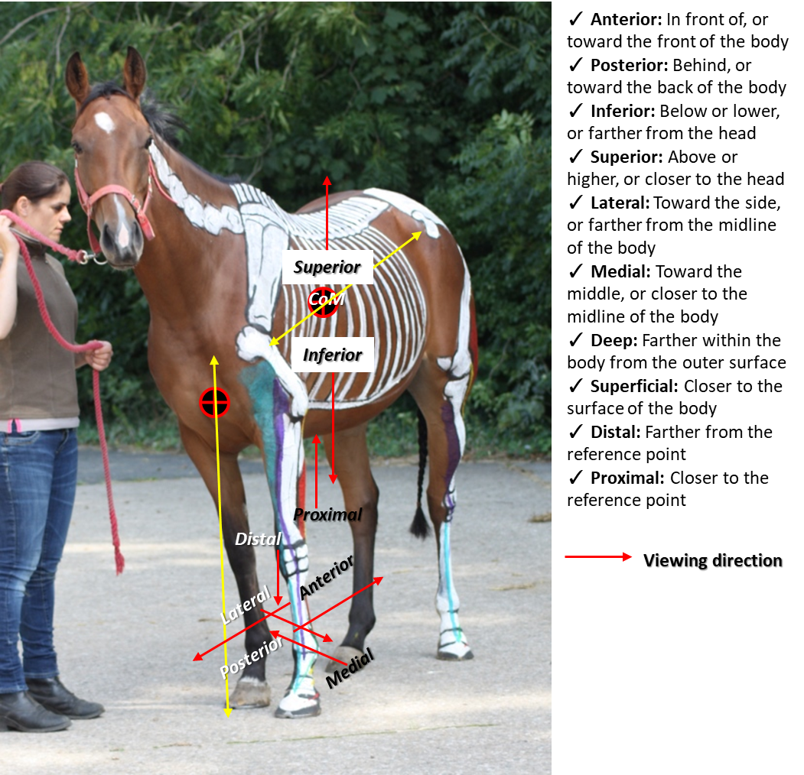
Positional & directional terminology
Planes of reference
  Dorsal
  Ventral
  Left / near
  Right / off

Slide 6
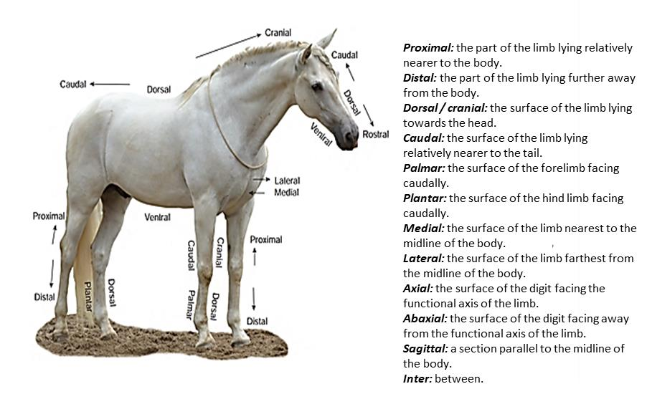
Positional & directional terminology

Slide 7
Positional and Directional Terminology
Descriptions for the position or direction of travel of different parts of an animal need to be precise and clear, particularly for the purposes of an examination. For this reason it will be necessary to use a standard terminology wherever possible.
Axial: | Towards the centre (nearer to the axis)
Abaxial: | Away from the centre (away from the axis)
Basal: | The lowest (surface)
Deep: | Internal, close to the centre mass
Digit: | The part of the leg below the fetlock joint
Distal: | Furthest from the body (bottom)
Dorsal: | Front surface of the legs

Slide 8
Positional and Directional Terminology
Extend: | To straighten (a limb)
Extensor: | A structure whose function is to extend
Flex: | To bend (a limb)
Flexor: | A structure whose function is to flex
Lateral: | Outside (of the legs)
Medial: | Inside (of the legs)
Palmer: | Rear of the fore leg
Plantar: | Rear of the hind leg
Proximal: | Closest to the body (top)
Sagital: | A vertical plane through the legs. Parallel to the median plane
Superficial: | External, close to the surface
The above is not an exhaustive list. Other items may be used in some circumstances but the meaning must be clear if in doubt leave it out.

Slide 9
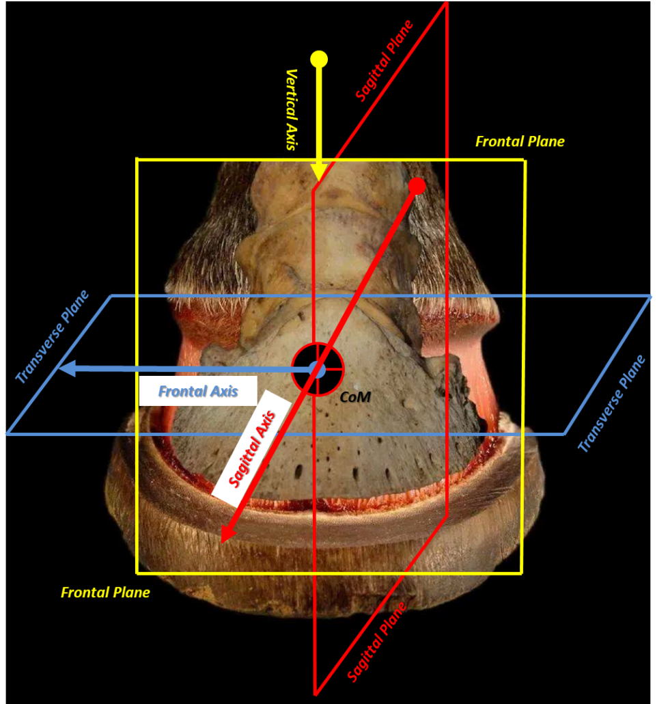
Positional and Directional Terminology
Planes of reference
  Sagittal
  Transverse
  Frontal

Slide 10
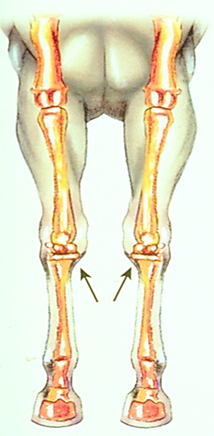
Positional and Directional Terminology
Axial towards the centre (nearer to the axis)
Abaxial away from the centre (away from the axis)

Slide 11
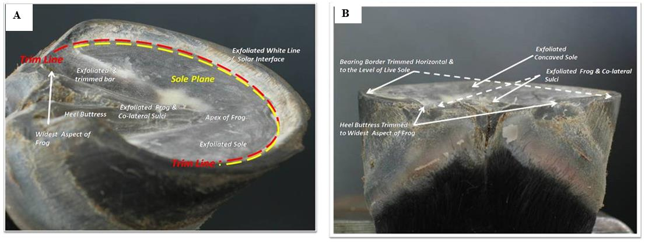
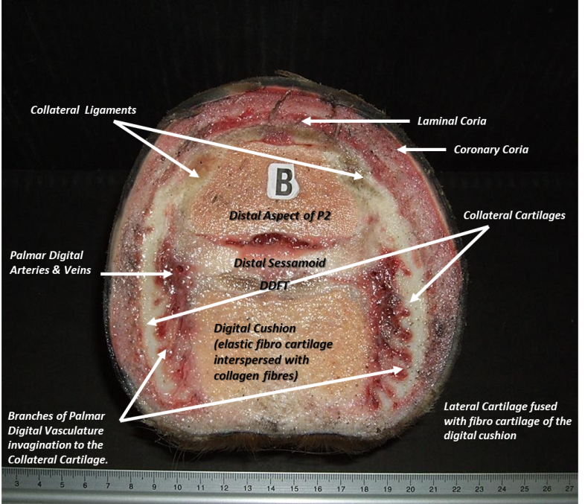
Positional and Directional Terminology
Basal the lowest (surface)
Deep internal, close to the centre of mass

Slide 12
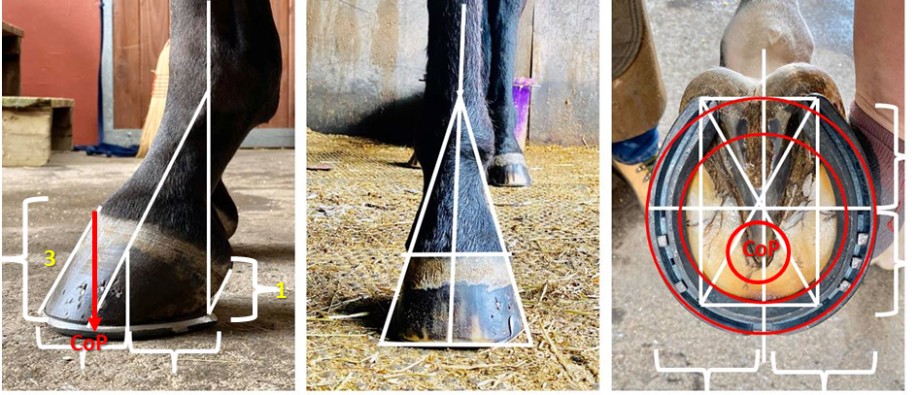
Positional & directional terminology
Digit the part of the leg below the fetlock joint
Dorsal front surface of the legs
Distal furthest from the body (bottom)

Slide 13
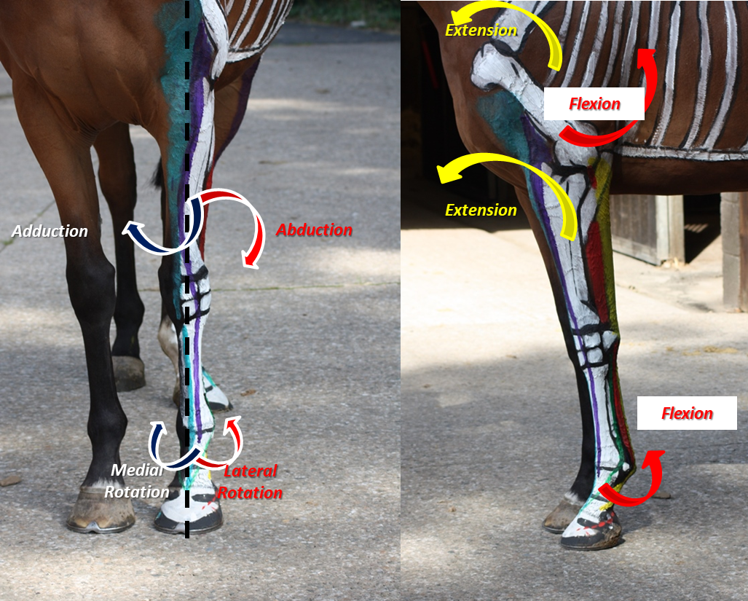
Positional & directional terminology
Extend to straighten (a limb)
Extensor a structure whose function is to extend

Slide 14
Positional & directional terminology
Flex to bend (a limb)
Flexor a structure whose function is to flex

Slide 15
Positional & directional terminology
Lateral outside (of the legs)
Medial inside (of the legs)
Palmar/Plantar rear of the fore leg

Slide 16
Positional & directional terminology
Proximal closest to the body (top)

Slide 17

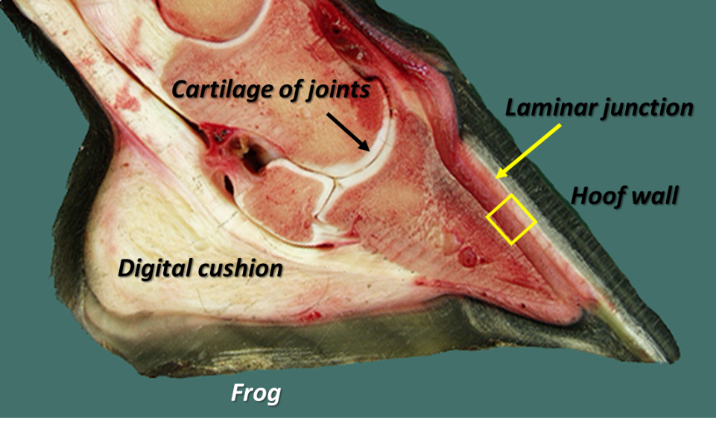
Positional & directional terminology
Sagittal a vertical plane through the legs. Parallel to the median plane

Slide 18
Positional & directional terminology
Superficial external, close to the surface

Slide 19
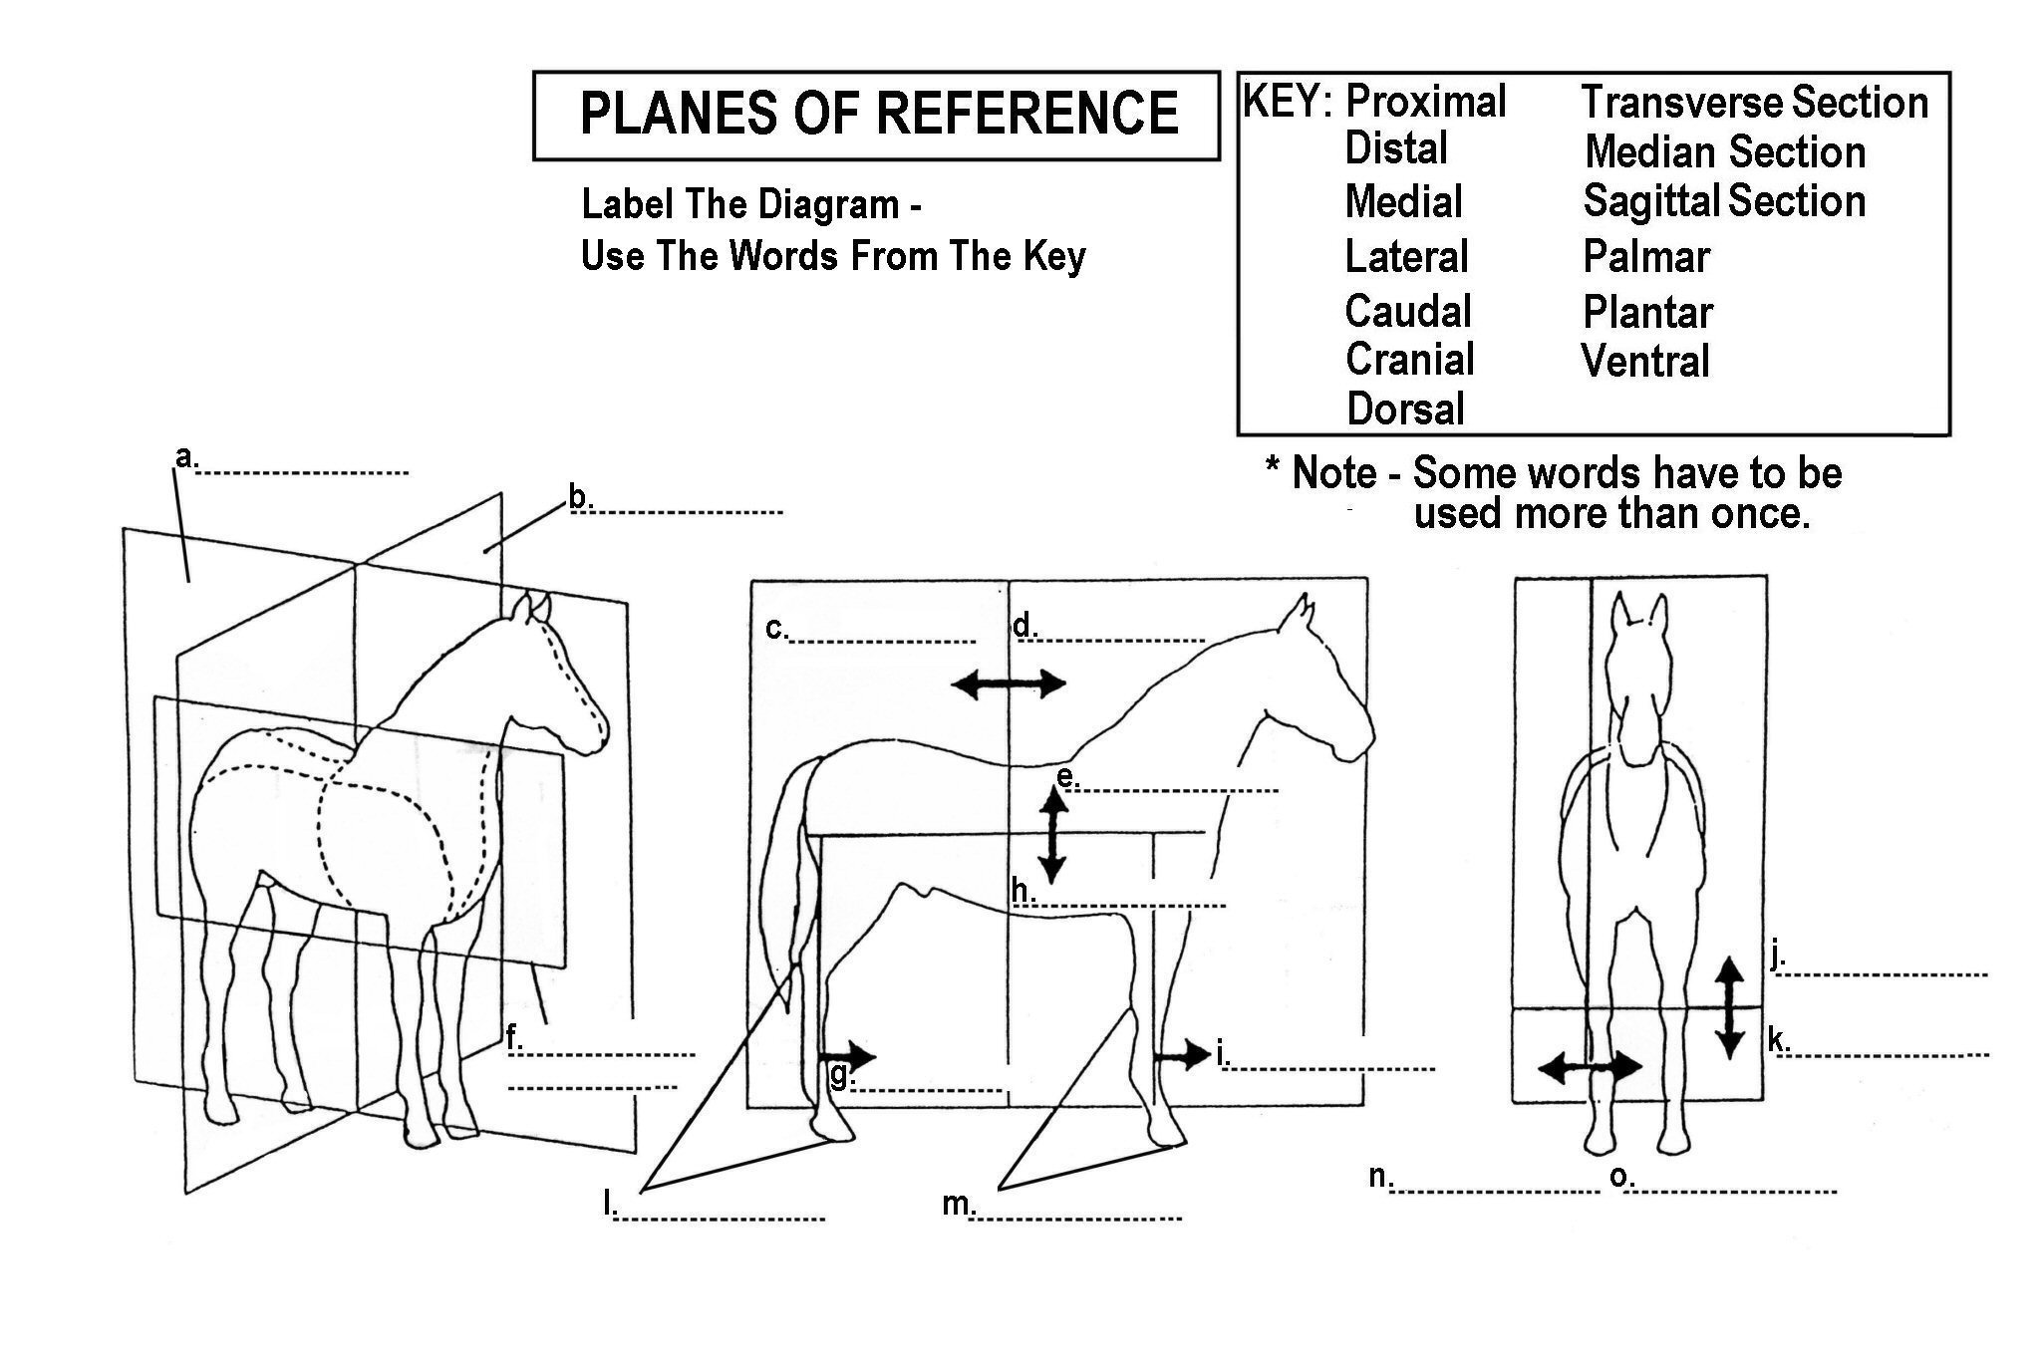
Quiz

Slide 20
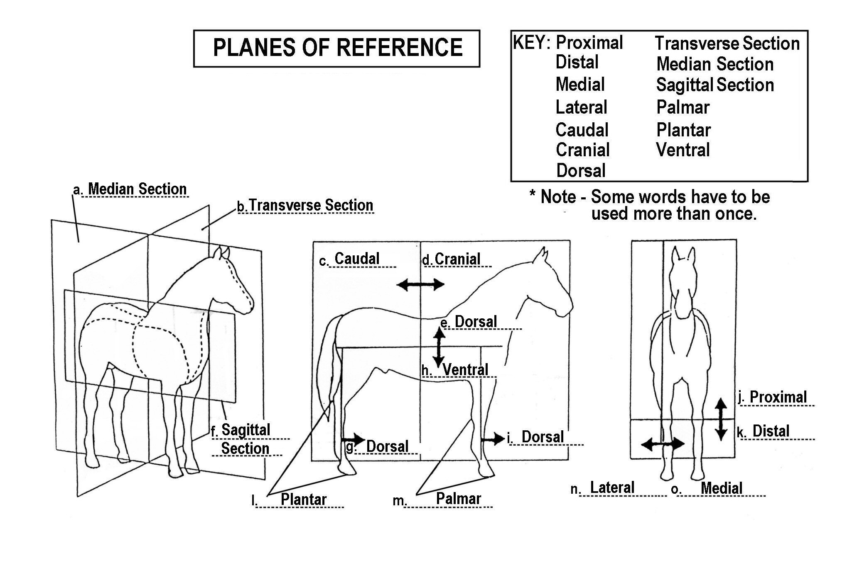
Answers

